Slide 1

PYTHON PROGRAMMING & DATA SCIENCE
UNIT - V

Slide 2
SYLLABUS
Introduction to Deep Learning: Multilayer perceptron. Back propagation. Loss functions. Hyper parameter tuning, Overview of RNN, CNN and LSTM.
Overview of Data Science Models: Applications to text, images, videos, recommender systems, image classification, Social network graphs.

Slide 3
Deep Learning
Deep Learning
Deep learning is a type of machine learning based on artificial neural networks in which multiple layers of processing are used to extract progressively higher level features from data.
Deep learning models are capable enough to focus on the accurate features themselves by requiring a little guidance from the programmer and are very helpful in solving out the problem of dimensionality.
Deep learning algorithms are used, especially when we have a huge no of inputs and outputs

Slide 4
Deep Learning
Deep learning is implemented with the help of Neural Networks, and the idea behind the motivation of Neural Network is the biological neurons, which is nothing but a brain cell.
“Deep learning is a collection of statistical techniques of machine learning for learning feature hierarchies that are actually based on artificial neural networks.”

Slide 5
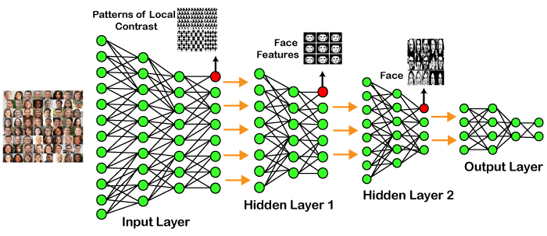
Example of Deep Learning

Slide 6
Example of Deep Learning
In the example given above, we provide the raw data of images to the first layer of the input layer.
After then, these input layer will determine the patterns of local contrast that means it will differentiate on the basis of colors, luminosity, etc.
Then the 1st hidden layer will determine the face feature, i.e., it will fixate on eyes, nose, and lips, etc. And then, it will fixate those face features on the correct face template.
So, in the 2nd hidden layer, it will actually determine the correct face here as it can be seen in the above image, after which it will be sent to the output layer.
Likewise, more hidden layers can be added to solve more complex problems, for example, if you want to find out a particular kind of face having large or light complexions.
So, as and when the hidden layers increase, we are able to solve complex problems

Slide 7
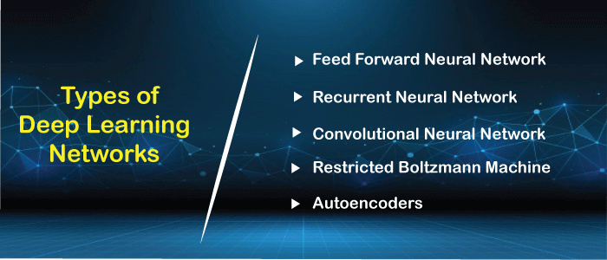
Types of Deep Learning Networks

Slide 8
Deep learning applications
Self-Driving Cars In self-driven cars, it is able to capture the images around it by processing a huge amount of data, and then it will decide which actions should be incorporated to take a left or right or should it stop. So, accordingly, it will decide what actions it should take, which will further reduce the accidents that happen every year.
Voice Controlled Assistance When we talk about voice control assistance, then Siri is the one thing that comes into our mind. So, we can tell Siri whatever we want it to do,it will search it and display it for us.

Slide 9
Deep learning applications
Automatic Image Caption Generation Whatever image that you upload, the algorithm will work in such a way that it will generate caption accordingly. If you say blue colored eye, it will display a blue-colored eye with a caption at the bottom of the image.
Automatic Machine Translation With the help of automatic machine translation, we are able to convert one language into another with the help of deep learning.

Slide 10
Limitations
It only learns through the observations.
It comprises of biases issues.

Slide 11
Advantages
It lessens the need for feature engineering.
It eradicates all those costs that are needless.
It easily identifies difficult defects.
It results in the best-in-class performance on problems.

Slide 12
Disadvantages
It requires an ample amount of data.
It is quite expensive to train.
It does not have strong theoretical groundwork.

Slide 13
Differences between machine learning and deep learning
While there are many differences between these two subsets of artificial intelligence, here are five of the most important:
1. Human Intervention
Machine learning requires more ongoing human intervention to get results. Deep learning is more complex to set up but requires minimal intervention thereafter.

Slide 14
Differences Contd…
2. Hardware
Machine learning programs tend to be less complex than deep learning algorithms and can often run on conventional computers, but deep learning systems require far more powerful hardware and resources.
3. Time
Machine learning systems can be set up and operate quickly but may be limited in the power of their results. Deep learning systems take more time to set up but can generate results instantaneously (although the quality is likely to improve over time as more data becomes available).

Slide 15
Differences Contd…
4. Approach
Machine learning tends to require structured data and uses traditional algorithms like linear regression. Deep learning employs neural networks and is built to accommodate large volumes of unstructured data.
5. Applications
Machine learning is already in use in your email inbox, bank, and doctor’s office. Deep learning technology enables more complex and autonomous programs, like self-driving cars or robots that perform advanced surgery.

Slide 16
Below is a table of differences between Machine Learning and Deep Learning:
S.No. | Machine Learning | Deep Learning
1. | Machine Learning is a superset of Deep Learning | Deep Learning is a subset of Machine Learning
2. | The data represented in Machine Learning is quite different as compared to Deep Learning as it uses structured data | The data representation is used in Deep Learning is quite different as it uses neural networks(ANN).
3. | Machine Learning is an evolution of AI | Deep Learning is an evolution to Machine Learning. Basically it is how deep is the machine learning.
4. | Machine learning consists of thousands of data points. | Big Data: Millions of data points.
5. | Outputs: Numerical Value, like classification of score | Anything from numerical values to free-form elements, such as free text and sound.
6. | Uses various types of automated algorithms that turn to model functions and predict future action from data. | Uses neural network that passes data through processing layers to the interpret data features and relations.
7. | Algorithms are detected by data analysts to examine specific variables in data sets. | Algorithms are largely self-depicted on data analysis once they’re put into production.
8. | Machine Learning is highly used to stay in the competition and learn new things. | Deep Learning solves complex machine learning issues.

Slide 17
THANK YOU

